Slide 1
Compiler
Chang Chi-Chung
2007.03.01

Slide 2
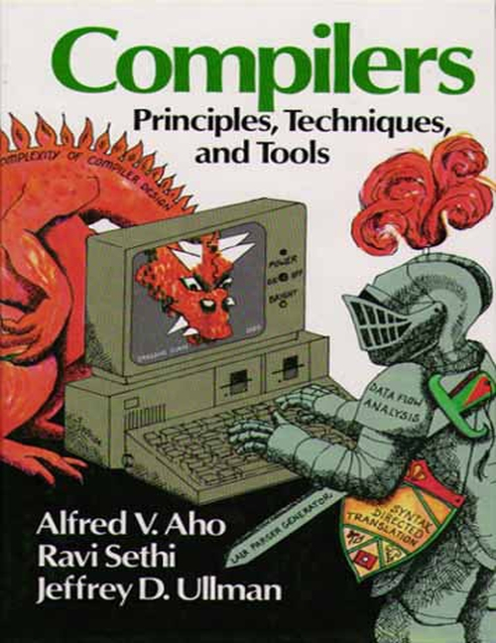
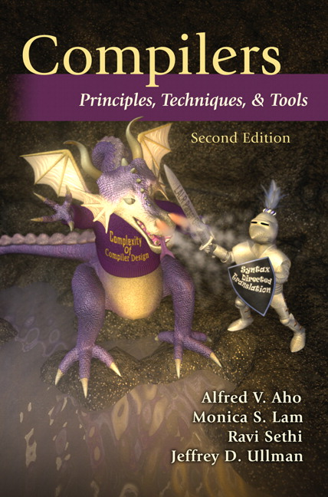
Textbook
Compilers: Principles, Techniques, and Tools, 2/E.
  Alfred V. Aho, Columbia University
  Monica S. Lam, Stanford University
  Ravi Sethi, Avaya Labs
  Jeffrey D. Ullman, Stanford University
Dragon

Slide 3
Score
Midterm Examination 20%
Final Examination 25%
Quizz(2) 30%
Project or Homework 15%
Participation 10%

Slide 4
Objectives
瞭解編譯器的構建原理
  Know how to use compiler construction tools, such as generators of scanners and parsers
  Be able to define LL(1), LR(1), and LALR(1) grammars
  Be familiar with compiler analysis and optimization techniques
建立屬於自己的編譯器

Slide 5
Use the Compiler Techniques
Programming Languages (C、C++…)
Scripts (Javascript、bash)
Editors (syntax highlighting)
Pretty printers (e.g. Doxygen)
Static checkers (e.g. Lint and Splint)
Interpreters
Text formatters (e.g. TeX and LaTeX)
Silicon compilers (e.g. VHDL)
Query interpreters/compilers (Databases)

Slide 6
Programming Languages
低階語言
machine dependent
高階語言
machine independent
自然語言
none
機器語言
組合語言
C、C++、Java …
Chinese
English
German

Slide 7
Compilers 編譯器
“Compilation”
  Translation of a program written in a source language into a semantically equivalent program written in a target language
Input
Source
Program
Compiler
Target
Program
Error messages
Output

Slide 8
Interpreters 直譯器
“Interpretation”
  Performing the operations implied by the source program
Source
Program
Interpreter
Output
Input
Error messages

Slide 9
Compiler vs. Interpreter
請自己蒐集資料比較
 | Compiler | Interpreter
翻譯次數 | 1 | More
除錯 | 較難 | 較易

Slide 10
Preprocessors, Compilers, Assemblers, and Linkers
Skeletal Source Program
Preprocessor
Source Program
Try for example:
gcc -v myprog.c
Compiler
Target Assembly Program
Assembler
Relocatable Object Code
Linker
Libraries and
Relocatable Object Files
Absolute Machine Code

Slide 11
The Analysis-Synthesis Model of Compilation
There are two parts to compilation:
  Analysis determines the operations implied by the source program which are recorded in a tree structure
  Synthesis takes the tree structure and translates the operations therein into the target program

Slide 12
The Phases of a Compiler
Phase | Output | Sample
Programmer (source code producer) | Source string | A=B+C;
Scanner (performs lexical analysis) | Token string | ‘A’, ‘=’, ‘B’, ‘+’, ‘C’, ‘;’ And symbol table with names
Parser (performs syntax analysis based on the grammar of the programming language) | Parse tree or abstract syntax tree | ; | = / \ A + / \ B C
Semantic analyzer (type checking, etc) | Annotated parse tree or abstract syntax tree
Intermediate code generator | Three-address code, quads, or RTL | int2fp B t1 + t1 C t2 := t2 A
Optimizer | Three-address code, quads, or RTL | int2fp B t1 + t1 #2.3 A
Code generator | Assembly code | MOVF #2.3,r1 ADDF2 r1,r2 MOVF r2,A
Peephole optimizer | Assembly code | ADDF2 #2.3,r2 MOVF r2,A

Slide 13
The Grouping of Phases
Compiler front and back ends:
  Front end: analysis (machine independent)
  Back end: synthesis (machine dependent)
Compiler passes:
  A collection of phases is done only once (single pass) or multiple times (multi pass)
    Single pass: usually requires everything to be defined before being used in source program
    Multi pass: compiler may have to keep entire program representation in memory

Slide 14
Compiler-Construction Tools
Software development tools are available to implement one or more compiler phases
  Scanner generators
  Parser generators
  Syntax-directed translation engines
  Automatic code generators
  Data-flow engines

